Slide 1
Scrum-Agile Approach
Key Facets and Benefits

Slide 2
Overview
Agile Manifesto principles
Scrum framework
Key roles
Agile Phases
Comparison and Scenario

Slide 3
Agile Manifesto Principles
Individuals and interactions over processes and tools
Working software over comprehensive documentation
Customer collaboration over contract negotiation
Responding to change over following a plan
(Lowell, 2023)
Notes:
Lowell, K. R. (2023). Leading Modern Technology Teams in Complex Times: Applying the Principles of the Agile Manifesto. Springer, 15–15. https://doi.org/10.1007/978-3-031-36429-7

Slide 4
Scrum Framework
Empirical process: Transparency, Inspection, and Adaptation
Sprints: Time-boxed iterations (typically 2-4 weeks)
Three pillars: Accountability, Commitment, and Focus
(Sassa et al., 2023)
Notes:
Sassa, A. C., Alves de Almeida, I., Pereira, T., & Silva de Oliviera, M. (2023). Scrum: A Systematic Literature Review. International Journal of Advanced Computer Science and Applications, 14(4). https://doi.org/ DOI:10.14569/IJACSA.2023.0140420

Slide 5
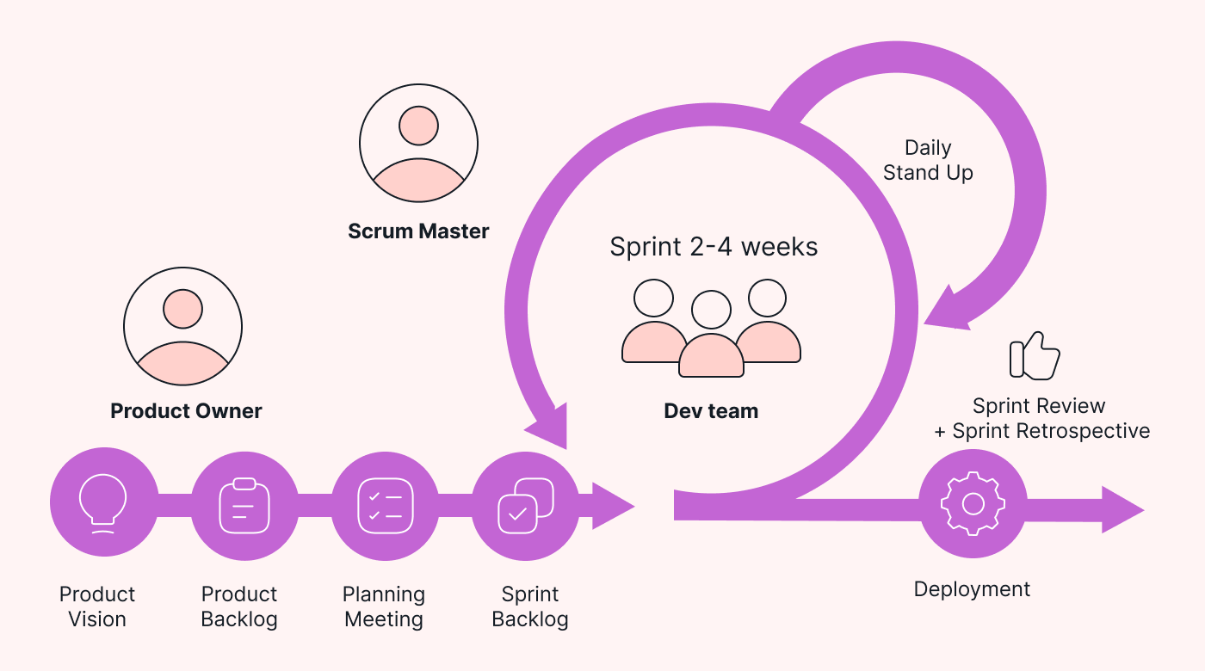
Notes:
Blog, M. (2023, August 30). Scrum framework 101: Everything to know. RSS. https://cdn.prod.website-files.com/62fcfcf2e1a4c21ed18b80e6/64ef47a94e9c500c81c2cf59_scrum_roles_wb5v.png

Slide 6
Key Roles
Product Owner
effectively communicates the vision for the project and actively engages with the Development Team during Sprint Planning, Sprint Review, and Sprint Retrospective.
Development Team
collaboratively solves problems and adapts to changes in project requirements during the Sprint.
Scrum Master
Regularly updates the Product Backlog based on new business requirements and user feedback.
(Cobb, pg. 276-278, Table 16.2)
Notes:
Cobb, C. G. (n.d.). In The Project Manager’s Guide to Mastering Agile: Principles and Practices for an Adaptive Approach (pp. 381–382). Book. Retrieved August 13, 2024,.
Cobb, C. G. (n.d.). In The Project Manager’s Guide to Mastering Agile: Principles and Practices for an Adaptive Approach (pp. 381–382). Book. Retrieved August 13, 2024,.

Slide 7
Agile Phases
Inception
Determine project feasibility and resources.
Set project's direction.
Elaboration
Consider architectures, resources, and development costs.
Create a detailed design plan.
Construction
Design, write, and test the software
Transition
Release and address feedback, make necessary adjustments.
(Cobb, pg. 382)
Notes:
Cobb, C. G. (n.d.). In The Project Manager’s Guide to Mastering Agile: Principles and Practices for an Adaptive Approach (pp. 381–382). Book. Retrieved August 13, 2024,.

Slide 8
Waterfall or Agile?
Simple, well-defined projects
Fixed timelines, thorough documentation
Individual responsibility
Project Complexity
Time Constraints
Team Expertise
Complex and evolving projects
Adaptability, quicker turnaround
Communication and collaboration
HOW DO THEY PERFORM?
(Mokhtar & Khayyat, 2022)
Notes:
Mokhtar, R., & Khayyat, M. (2022). A comparative case study of Waterfall and Agile Management. SAR Journal - Science and Research, 52–62. https://doi.org/10.18421/sar51-07

Slide 9
Scenario A key requirement changes during development
Waterfall Approach:
Revisiting previous phases, potentially causing delays
Rework and re-test to accommodate the change
Formal change request process and impact analysis
Agile Approach:
Adapt the Product Backlog and user stories
Collaborate to adjust design and implementation
Flexibly accommodate changes within the current Sprint

